Slide 1
Hackschool X-Plat
Steffen Jahr & Sebastian Gingter Thinktecture AG

Slide 2

Your Hosts
Steffen Jahr
Sebastian P.R. Gingter
Software Developer @TT
Fokus:
Frontend Angular2 NodeJS
Software Engineer @TT Fokus:
Backend TypeScript C# / .NET Core

Slide 3
Agenda
Intro & Setup 09:30 - 11:00
Angular 2 11:15 - 12:45
Ng 2 & Cordova 13:30 - 15:00
Cordova & FAQ 15:15 - 16:45

Slide 4
Intro
Was haben wir vor?

Slide 5
Setup
Repository: https://github.com/thinktecture/ hackschool-crossplatform

Slide 6
API
Mini Pokémon API
Im Ordner API:
npm i
npm start

Slide 7
Angular 2
Was ist Angular?
Was ist es nicht?

Slide 8
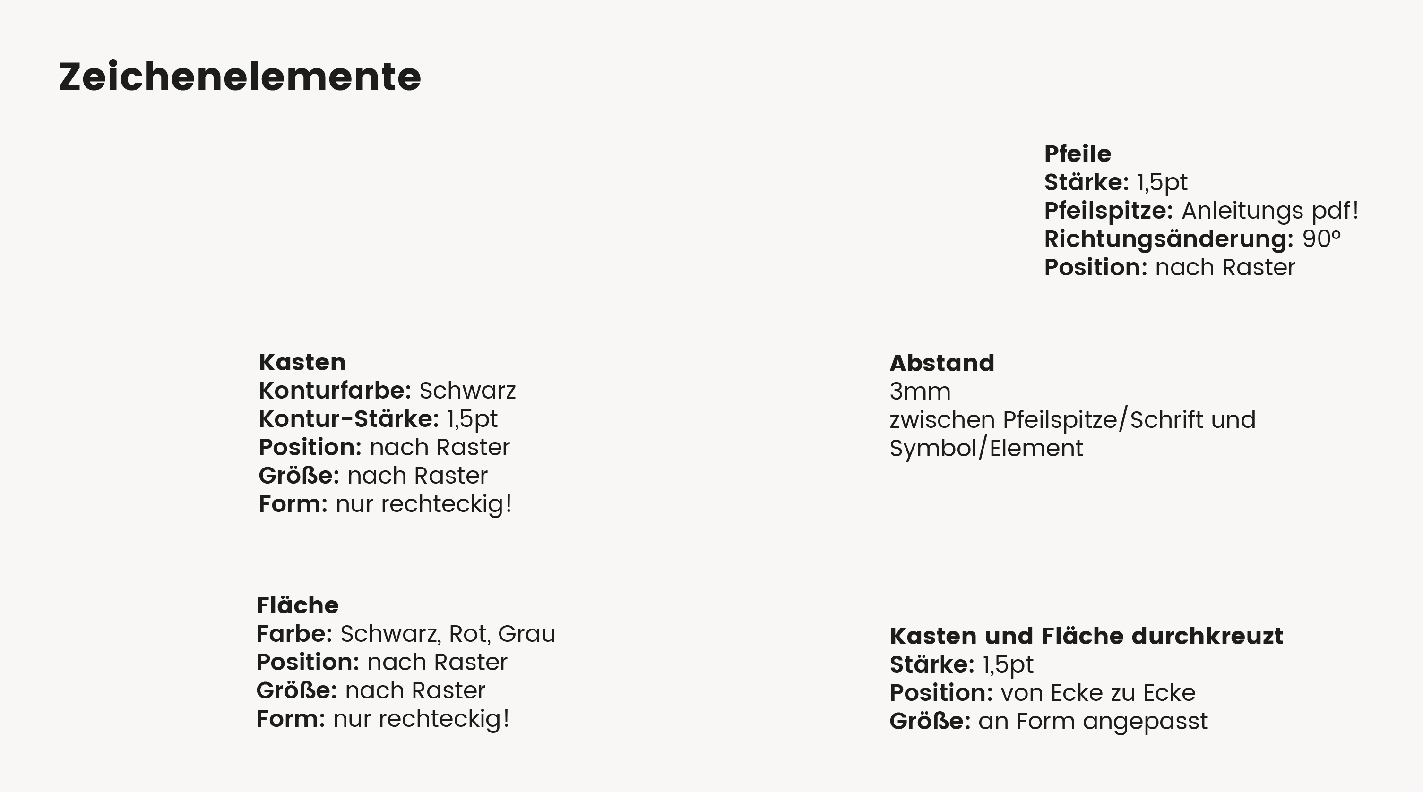



Slide 9
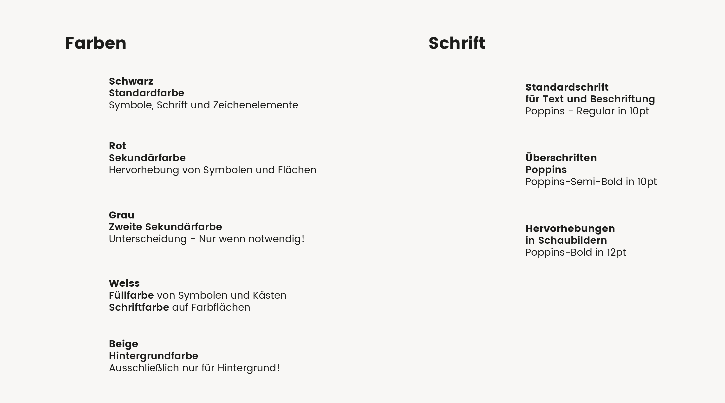
Text
Headline
Important

Slide 10
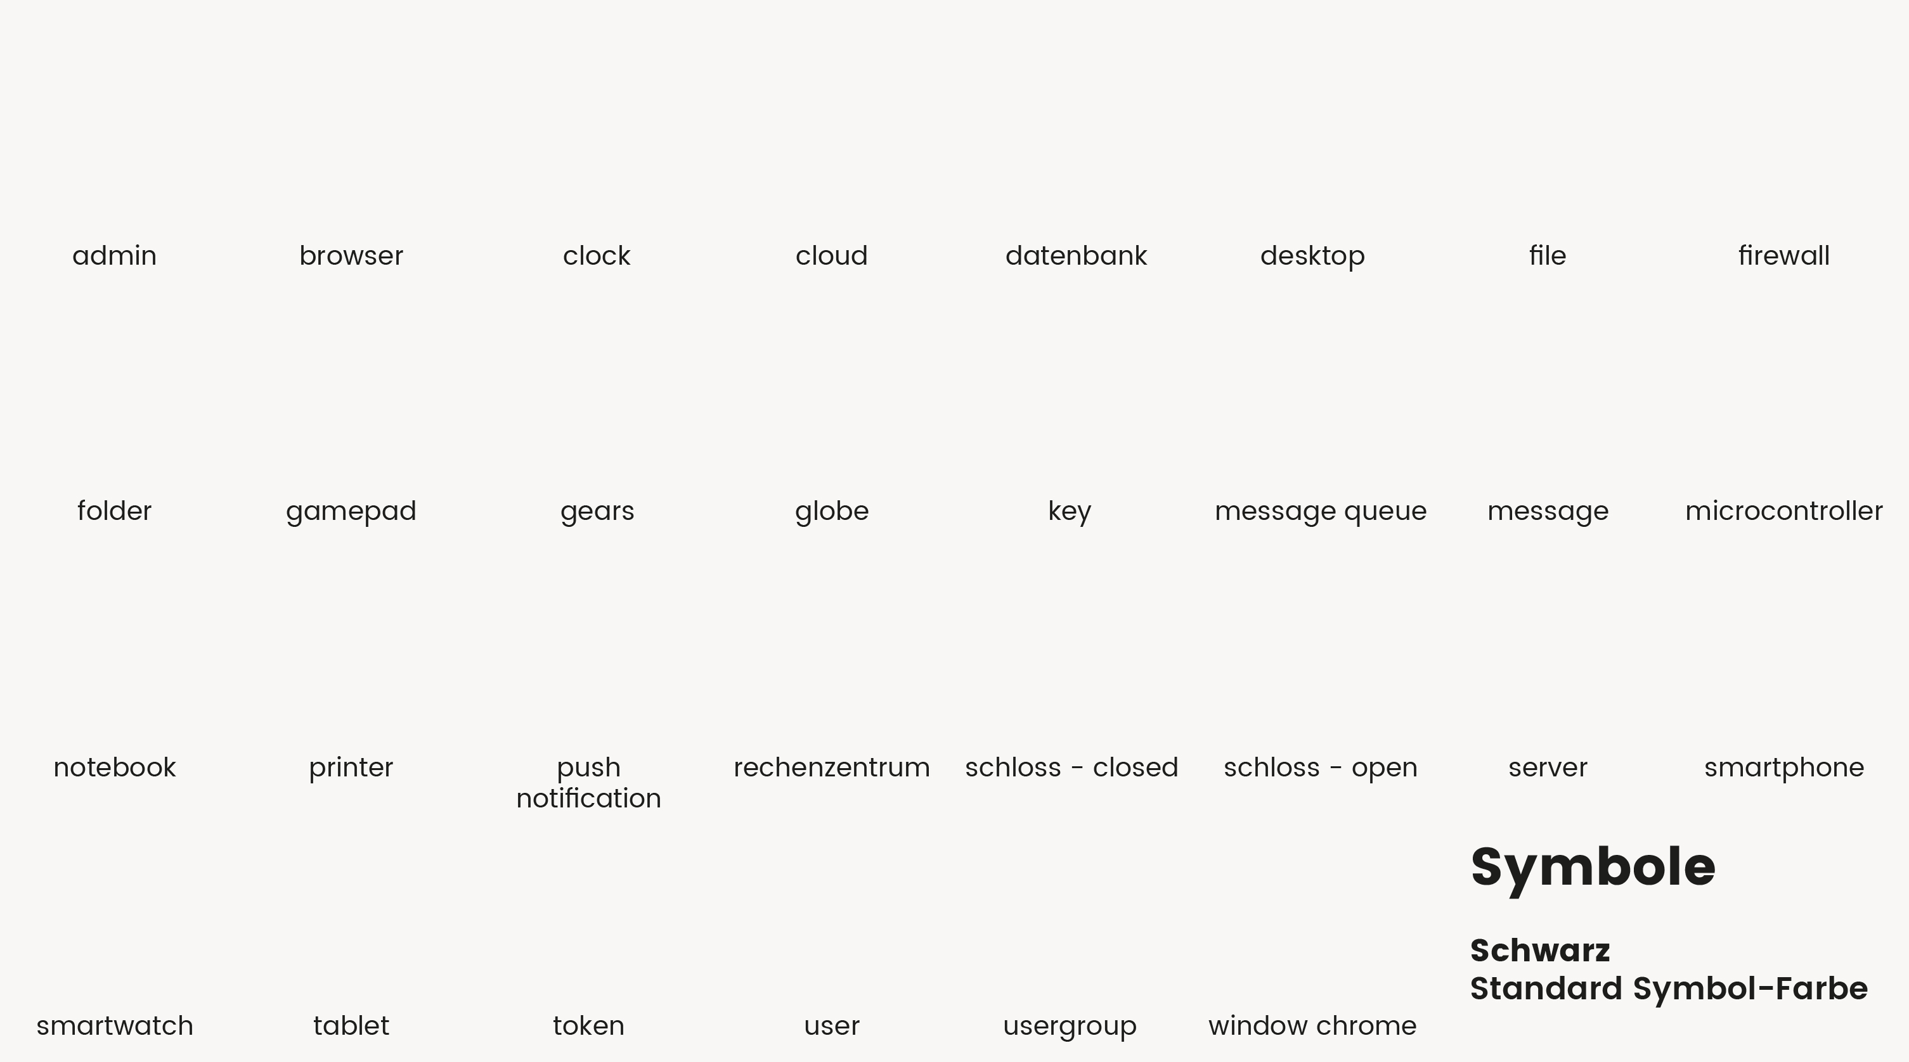





























Slide 11
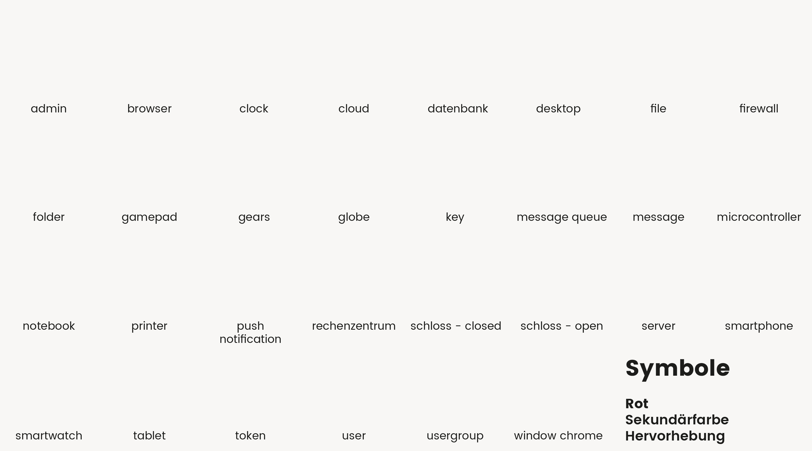































Slide 12
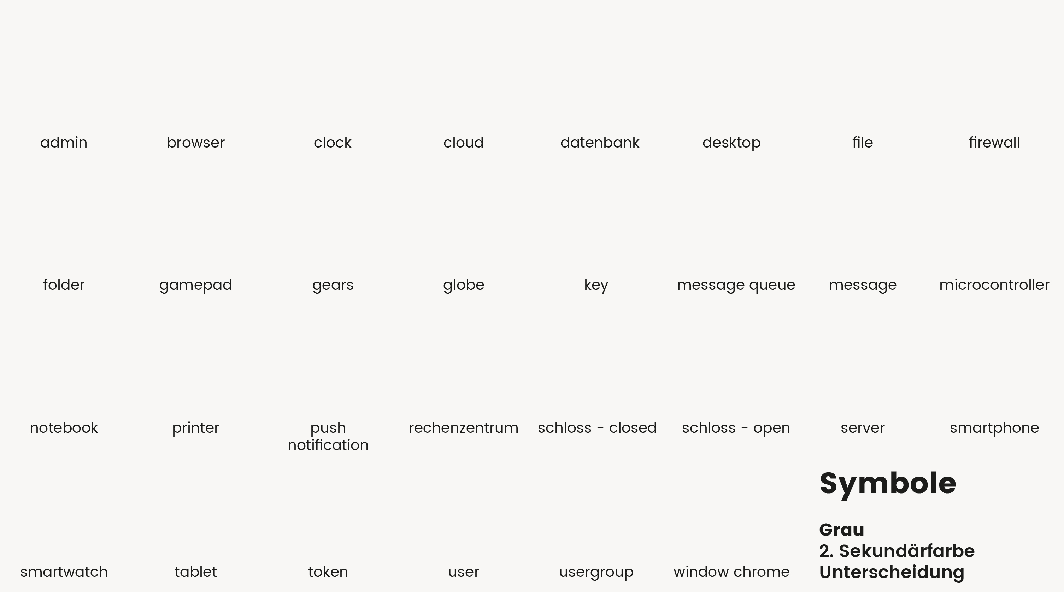































Slide 13

Thinktecture
Relay Server
6, 8, 10
Temporary Storage
1
7
HTTP Request
Request Handler
4
Real-time socket
5
9
Client
On-Premise Connector
Service
3
12
2, 11
HTTP Response
Message Queue
Thinktecture
Relay Server

Slide 14
Headline
Subheadline

